Slide 1


A Framework for the Definition and Analysis of Cyber Insurance Requirements
Master Project - Final Presentation
Viktor Matejka, Juan Huacan
Supervisors: Muriel Franco, Eder Scheid
Communication Systems Group CSG Department of Informatics IfI University of Zürich UZH
June 25th, 2021

Slide 2
Table of Contents
Methodology
Interviews with Experts
Refinement of the Framework
Premium Calculation
Case Studies (Application of the Framework)
Conclusions & Future Work

Slide 3
METHODOLOGY

Slide 4
Methodology
BEFORE MID-TERM PRESENTATION
SINCE MID-TERM PRESENTATION
1
2
3
4
5
5
6
LITERATURE REVIEW
MAPPING OF STAKEHOLDERS
DEFINITION OF FRAMEWORK
INTERVIEW WITH EXPERTS
REFINEMENT OF FRAMEWORK
PREMIUM CALCULATION
EVALUATION
100+ papers scanned. 34 analysed. 9 key selected. Conducted concept mapping.
Identify all relevant and key stakeholders and their interactions.
Define a cyber insurance framework based on the literature review
Conduct interviews with experts in the cyber insurance field to validate our framework
Apply suggestions and feedback to our framework. The outcome is the final refine framework
Review different premium calculations methods based on current industry practices
Evaluate the premium calculation based on a case study

Slide 5
Literature Review
Analysis
The selected papers were studied to extract all the information about the current frameworks that exist already in the market. Our proposed framework was created from this source of information.
1
3
Paper selection
According to our project’s interests, approx. 34 papers were selected as part of our related work.
2
2
Search
Over 136 papers were found following different searching techniques. They are considered our source of information through all the present project.
1
3

Slide 6
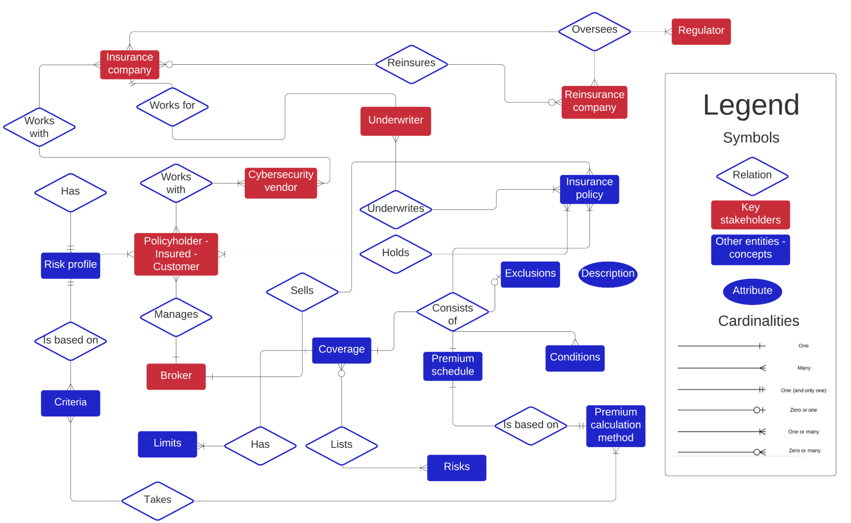
Mapping of Stakeholders

Slide 7
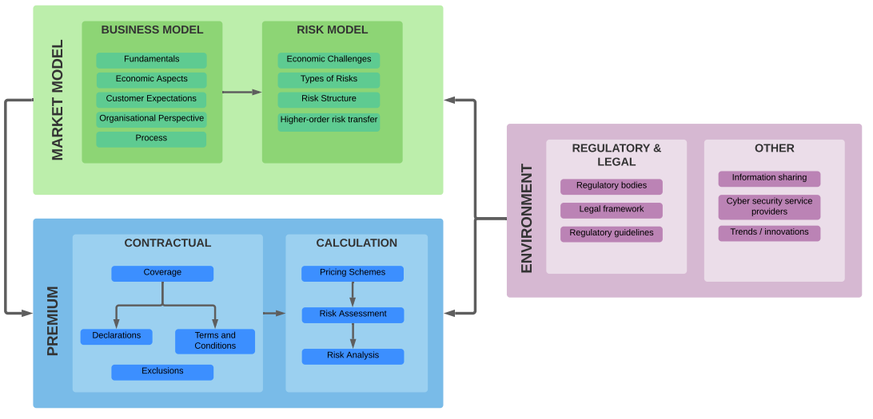
Definition of the Framework

Slide 8
INTERVIEWS WITH EXPERTS

Slide 9



Interviews & Survey - the setup
Contact 15 senior cyber insurance experts through Linkedin.
3 of them agreed to have an interview
Demographics
Number of interviewees : 3 experts
Experience : 7-15 years
Role : Underwriters & Cyber risk Analysts
Anonymous Global Insurance Company

Slide 10
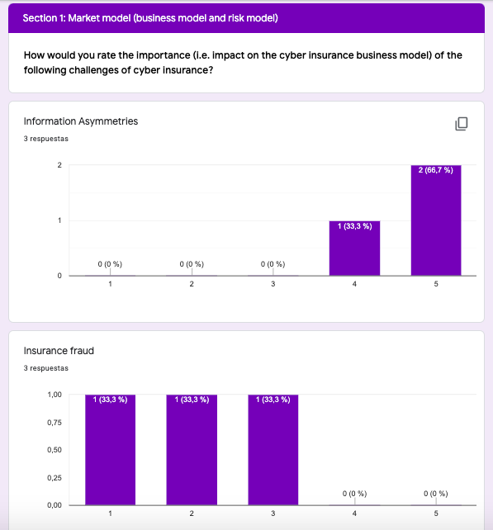

Structure of interview
Semi-structured interview
Survey
General Information
Framework

Slide 11
Interviews with experts - Takeaways
Framework Pillar | General Information
Market Model | Challenges of cyber insurance | Interdependent security/Systemic risks Reputational risks Limited actuarial data
Premium and Contract Design | Methods used for underwriting process | Questionnaires Security audits Partnerships with cyber-security vendors
 | Most relevant steps of cyber insurance process | Claim handling Individual risk estimation
Environment | Regulation | Cyber insurance well regulated

Slide 12
Interviews with experts - Takeaways
Framework Pillar | Feedback
Market Model | Suitable for users that begin in this field, it is complete (e.g. start-ups). Too broad for seasoned insurers already in the business. Emphasize the importance for companies to do both: reinforce security standards and get cyber insurance. Importance of cyber reinsurance confirmed
Premium calculation | Unanimous agreement of completeness and understandability of this pillar. IMPORTANT: Confirmation of base rate with modifications
Environment | Emphasize the presence of “external malicious attacks”

Slide 13
REFINEMENT OF THE FRAMEWORK

Slide 14
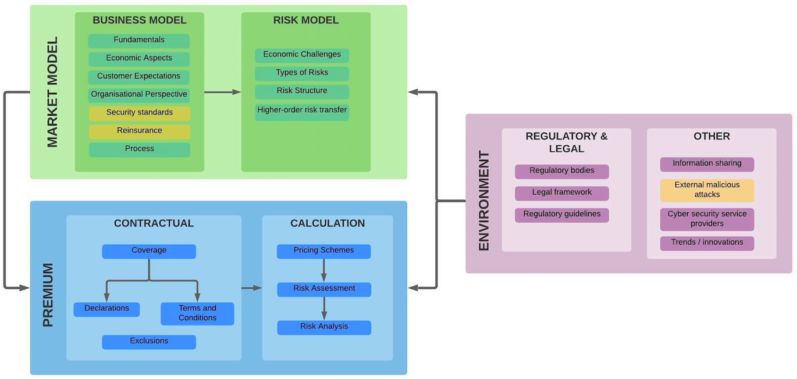
Refinement of the framework

Slide 15
PREMIUM CALCULATION

Slide 16
Premium Calculation
Literature review
Empirical analysis: Challenges and approach to analysis
Outcomes
What can be generalised about premium calculation?
Typical premium calculation process
What can not?
Heterogeneity in policies, risk segmentation, assumptions

Slide 17
Literature review: Key papers on modelling and pricing
Paper | Title | Risk Modelling | Premium Calculation | Data Sources
Böhme et al. (2019) | A Fundamental Approach to Cyber Risk Analysis | YES | NO | YES
Bardopoulos (2020) | CYBER-INSURANCE PRICING MODELS | YES | NO (focus on model) | YES
Romanovsky et al. (2019) | Content analysis of cyber insurance policies: how do carriers price cyber risk | NO | YES (review of policies) | partially
Xu & Hua (2017) | Cybersecurity Insurance: Modeling and Pricing | YES | YES | NO
Master Project Cyber Insurance Framework |  | in reference | YES (practical focus) | YES

Slide 18
Challenges - Premium calculation
Proprietary data
Intransparency and gap between documented process and practice
Underwriters apply discretion and “gut-feelings” when determining actual premiums in many cases
Number of modelling approaches (at least 23 different)

Slide 19
Solution - Empirical analysis
Clearly define scope and focus on production approaches of market leading companies (rather than proposals)
Choose SERFF (mandatory policy database in the U.S.) by NAIC as chief data source
Select a sample:
8 underwriting manuals, 34 contracts for analysis of coverage and exclusions (following methodology of Romanovsky et al.)
Analyse, reimplement (tabular calculations) and test
Compare
Extract a generalisable premium calculation process
Apply to case studies

Slide 20








What can be generalised about premium calculation?
Company | Chubb | Travelers | NYMAGIC | Zurich | Amerirust | Hiscox | BCS | HSB
Base rate | YES | YES | YES | YES | YES | YES | YES | YES
Base rate metric | Prospective fiscal year revenue | Total Assets Under Management | Limit/deductible combination | Annualized projected revenue | Revenue | Revenue (marginal calculation) | Total Interest Income x Rateable Revenue Factor | Combination of Annual Revenue and Net Operating Expenses
Industry segmentation | NO | YES | YES - for eligibility | YES | NO | YES | YES | YES
Other risk segmentation | Hazard groups | Business Classes | Tiers | Tiers | NO | Hazard Groups | Groups | Occupancy tiers
Information security pricing | YES | YES | NO | NO | NO | YES | YES | YES

Slide 21
Underwriting manuals/guidelines (regulatory filings) used for the premium calculation chapter
Company | SERFF Number | Reference used in this report
Chubb | XX | UM1
Travelers | XX | UM2
NYMAGIC | XXXX | UM3
ZURICH | XX | UM4
AmeriTrust | XX | UM5
HISCOX | XSX | UM6
BCS | XX | UM7
HSB by Munich Re | XX | UM8

Slide 22
What can not be generalised about premium calculation?
Contracts highly heterogeneous
Different terminology and coverage definitions
Some differences in exclusions
Different risk segmenting
Geographic differences

Slide 23
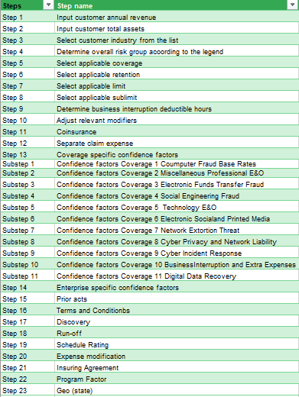
Formula/process heterogeneity across different policies
Example
Example
Steps | Step name
Step 1 | Determine Tier
Step 2 | Determine Revenue
Step 3 | Select Base Rate (using Linear Interpolation)
Step 4 | (OPTIONAL) Apply Increased Limit Factor based on Tier
Step 5 | (OPTIONAL) Sublimit Adjustment Factor
Step 6 | (OPTIONAL) Qualifying Period Factor
Step 7 | (OPTIONAL) Protection Period Factor
23 vs. 7 steps foreseen

Slide 24
CASE STUDY (APPLICATION OF FRAMEWORK)

Slide 25
Case Study: eCommerce
Set-up: Insurance company wants to enter the cyber insurance market by offering coverage to mid sized to eCommerce companies interested in purchasing business interruption policy (e.g. due to DDoS, Privacy Breach, Security Breach, Administrative Error ...)
Case study goals:
Holistic application of the framework
Demonstration of typical premium calculation
Pricing in absolute terms not in focus
Case summary: Key inputs
Modelled after an actual European eCommerce company
Revenue: 43 000 000,00 CHF
Asset size: 314 000 000,00 CHF
Industry: Home & Furniture Retail / eCommerce with some physical locations

Slide 26
Case Study: Market Model Pillar
Customer expectations: Streamlined process (small ticket comparatively)
Selected Key Coverage: Business Interruption (first-party) - however, most steps (and some modifiers) analogous for other types of coverage
Underwriting process: Questionnaire / underwriting meeting (broker)
Reinsurance: Some type non-proportional reinsurance treaty agreement (or reinsurance pool) to cover for possible aggregation
Notes:
Critical question: What is covered when ransomware attack causes a blackout?
Answer: Cyber and privacy insurance policies termed "cyber-extortion coverage". typically cover (1) monies to pay ransom demands, (2) experts to negotiate with hackers, and (3) the cost of computer forensics expert.
Excess of loss reinsurance can have three forms - "Per Risk XL" (Working XL), "Per Occurrence or Per Event XL" (Catastrophe or Cat XL), and "Aggregate XL".
In per risk, the cedant's insurance policy limits are greater than the reinsurance retention. For example, an insurance company might insure commercial property risks with policy limits up to $10 million, and then buy per risk reinsurance of $5 million in excess of $5 million. In this case a loss of $6 million on that policy will result in the recovery of $1 million from the reinsurer. These contracts usually contain event limits to prevent their misuse as a substitute for Catastrophe XLs.
In catastrophe excess of loss, the cedant's retention is usually a multiple of the underlying policy limits, and the reinsurance contract usually contains a two risk warranty (i.e. they are designed to protect the cedant against catastrophic events that involve more than one policy, usually very many policies). For example, an insurance company issues homeowners' policies with limits of up to $500,000 and then buys catastrophe reinsurance of $22,000,000 in excess of $3,000,000. In that case, the insurance company would only recover from reinsurers in the event of multiple policy losses in one event (e.g., hurricane, earthquake, flood).
Aggregate XL affords a frequency protection to the reinsured. For instance if the company retains $1 million net any one vessel, $5 million annual aggregate limit in excess of $5m annual aggregate deductible, the cover would equate to 5 total losses (or more partial losses) in excess of 5 total losses (or more partial losses). Aggregate covers can also be linked to the cedant's gross premium income during a 12-month period, with limit and deductible expressed as percentages and amounts. Such covers are then known as "stop loss" contracts.

Slide 27
Case Study: Premium Pillar
Overall setup
Pricing scheme: Base rate with modifications
Risk assessment - 2 options for the case
either broker model (supports risk assessment) with underwriter approval
or automated underwriting engine based on self-assessment (legally binding), possibly with underwriter approval/manual adjustments
Risk analysis - actuarial data / modifier value source used in the case study: Chubb Reinsurance (SERFF database)

Slide 28
Case Study: Premium Pillar
Premium Calculation
Steps | Step name | Result | Comments | Framework mapping
Step 1 | Input customer annual revenue | 47 000 000,00 CHF |  | Risk assessment
Step 2 | Determine overall risk group (0-6) | 2 | Material amounts of new records and generally store Material amounts of historical Moderately-critical products | Risk modelling and risk assessment
Step 3 | Select applicable coverage | Business Interruption | Malicious cyber act causes cyber damage | Contractual - coverage
Step 4 | Select applicable base rate | CHF 3974 | Linear interpolation on actuarial tables | Risk modelling
Step 5 | Select applicable retention | CHF 10k retention | 0.975 | Contractual - coverage
Step 6 | Select applicable limits and sublimits | CHF 1M per occurrence / aggregate |  | Contractual - coverage
Step 7 | Determine business interruption deductible hours | 5 | 1.20 factor | Contractual - coverage
Step 8 | Adjust relevant limit modifiers | 750k | 0.875 factor, revenue in a typical week | Contractual - coverage
Step 9 | Coverage specific confidence factors | 1 | overall Alpha (C) assumed 1 | Risk assessment
Step 10 | Enterprise specific confidence factors | 1 | overall Alpha (E) assumed 1 | Risk assessment
Step 11 | Annual premium (business interruption) | CHF 4068 | analogous process would be applied to other coverage elements | Premium calculation

Slide 29
Case Study: Premium Pillar
Premium Calculation
Steps | Step name | Result | Comments | Framework mapping
Step 1 | Input customer annual revenue | CHF 1.4 bn. | the foundational metric to set the base rate | Risk assessment
Step 2 | Determine overall risk group acoording to the legend | Hazard group 3 | Material amounts of historical Moderately-critical products | Risk modelling
Step 3 | Select applicable coverage | Cyber Liability (see coverage description) | Malicious cyber act causes cyber damage | Contractual - coverage
Step 4 | Select applicable base rate | 35'597.00 CHF | Linear interpolation on actuarial tables | Risk modelling
Step 5 | Select applicable retention | 0.98 | CHF 10k retention | Contractual - coverage
Step 6 | Select applicable limits and sublimits | 10’000’000 CHF | CHF 1M per occurrence / aggregate | Contractual - coverage
Step 7 | Adjust relevant limit modifiers | N/A | Limit not modified | Contractual - coverage
Step 8 | Coverage-specific / risk-specific / individual confidence factors | 1 | overall Alpha (C) assumed 1 | Risk assessment
Step 10 | Enterprise specific confidence factors | 1 | overall Alpha (E) assumed 1 | Risk assessment
Step 11 | Annual premium (business interruption) | CHF 34707 | analogous process would be applied to other coverage elements | Premium calculation

Slide 30
Case Study: Premium Pillar
Premium Calculation
Steps | Step name | Result | Comments | Framework mapping
Step 1 | Input customer annual revenue | CHF 529 m. | the foundational metric to set the base rate | Risk assessment
Step 2 | Determine overall risk group acoording to the legend | Hazard group 3 | Substanial exposure, substatial number of records, substantially critical | Risk modelling
Step 3 | Select applicable coverage | Cyber Crime | Cyber Crime covers funds transfer fraud, computer fraud and social engineering fraud. | Contractual - coverage
Step 4 | Select applicable base rate | 2'642.65 CHF | Linear interpolation on actuarial tables | Risk modelling
Step 5 | Select applicable retention | 0.98 | CHF 10k retention | Contractual - coverage
Step 6 | Select applicable limits and sublimits | 10’000’000 CHF | CHF 1M per occurrence / aggregate | Contractual - coverage
Step 7 | Adjust relevant limit modifiers | N/A | Limit not modified | Contractual - coverage
Step 8 | Coverage-specific / risk-specific / individual confidence factors | 1 | overall Alpha (C) assumed 1 | Risk assessment
Step 9 | Enterprise-specific / overall confidence factors | 1 | overall Alpha (E) assumed 1 | Risk assessment
Step 10 | Final Premium (interpolated base rate times modifiers) | 2'576.58 CHF | analogous process would be applied to other coverage elements | Premium calculation

Slide 31
Case Study: Premium Pillar
Risk analysis & Segmenting risks
Company | Base rate metric | Risk Group | Industry Classification | Alpha (overall) | Default Limit | Retention
Chubb | Prospective fiscal year revenue | Hazard group 3 | N/A | 1 | 1000000 | 10000
Travelers | Annual Revenue | N/A | PUBLIC, PRIVATE and NON-PROFIT | 1 | 1000000 | 25000
NY Marine and General Insurance (HSB policy) | Flat by Tier, Limit and Deductible combination | Tier 2 | N/A | 1 | 1000000 | 10000
Zurich NA | Annualized projected revenue | Tier 2 | 57 Home Furniture, Furnishings and Equipment Stores | 1 | 1000000 | 25000
AmeriTrust ( Lloyd’s) | Annual Revenue | No risk groups (small business policy) | No risk groups (small business policy) | 1 | 1000000 | ?
Hiscox Insurance | Revenue (marginal calculation) | N/A | ALL COMPANIES | 1 | 1000000 | 10000
BCS | Total sales x Rateable Revenue Factor | Group 3 | eCommerce - Industry group 3 | 1 | 1000000 | based on revenue
HSB | Combination of Annual Revenue and Net Operating Expenses | Occupancy Tier 2 | N/A | 1 | 1000000 | 10000
SKIPPED - POSSIBLY FOR DISCUSSION

Slide 32
Case Study: Premium Pillar
Risk assessment: Information Security pricing example
Coverage specific
Enterprise specific
Business Interruption | Range (Low) | Range (High)
Critical Application Assessments | 0,75 | 1,25
Criticality of Network to Applicant | 0,75 | 1,25
Dependency on real time transactions | 0,75 | 1,25
Loss History | 0,75 | 1,25
Mirror/Backup Procedures | 0,75 | 1,25
Network Technology | 0,75 | 1,25
Risk Management for IR Planning | 0,75 | 1,25
Technology Risk Management Process | 0,75 | 1,25
Volatility/Recovery in Sales | 0,75 | 1,25
Modifier Description | Range (Low) | Range (High)
Centralized Policies & Procedures | 0,75 | 1,25
Financial Condition | 0,75 | 1,25
Nature of Operations | 0,75 | 1,25
Network Security | 0,75 | 1,25
Physical Security | 0,75 | 1,25
Quality of Service Provider Contracts | 0,75 | 1,25
Quality of Service Providers | 0,75 | 1,25
Risk Management Controls | 0,75 | 1,25

Slide 33
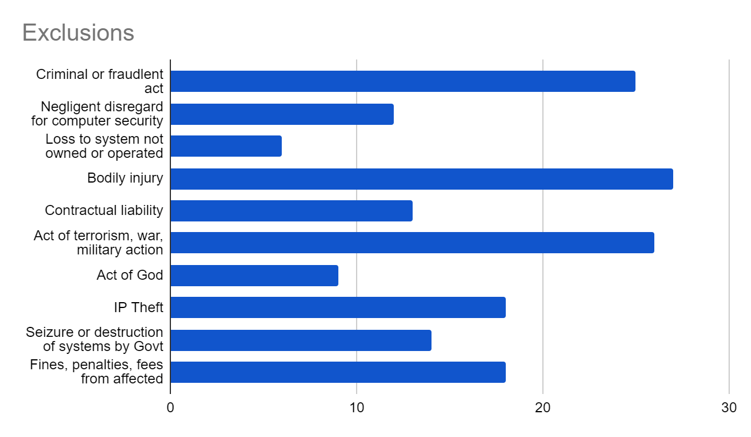
Case Study: Premium Pillar
Contractual: Typical exclusions
We analysed 34 policies (source: SERFF) and matched exclusions to common categories proposed by Romanovsky et al. to estimate the “typical ones” expected in a generalised contract

Slide 34
Environment: Data sharing How do insurers cope with information asymmetries?
Risk Analysis Tool | Link | Source | Value Proposition (according to vendor’s website)
Verisk Air Cyber Solutions | https://www.air-worldwide.com/ | Interviewee 1 | cyber risk modeling and analytics platform
Cysmo business suite | https://www.cysmo.de/en/index.html | Interviewee 1 | automated rating of a company's IT
Advisen specialty risk data | https://www.advisenltd.com/ | Interviewee 1 | specialty risk data
RMS Cyber Solutions | https://www.rms.com/ | Interviewee 1 | cyber risk analytics and cyber risk data
Bitsight | https://www.bitsight.com/ | Interviewee 3 | Security Rating independently correlated with breach risk and stock performance
Insight from interviews and empirical analysis: quantitative/alternative data either not used at all, or as a “second opinion” provided by a vendor (such as BitSight) and regarded typically as experimental and unreliable to determine actual premiums

Slide 35
CONCLUSIONS & FUTURE WORK

Slide 36
Conclusions
Project Goals | Conclusions
Survey on cyber insurance frameworks and models.
Define requirements, steps, metrics, and actors.
A structured research methodology was key to define the different processes, steps and stakeholders involved in the Cyber Insurance context (Process mapping, ER Model).
Definition and design of a cyber insurance framework.
A cyber insurance framework is definitely useful for new market entrants, less so for market leaders (broad approach)
Review of actuarial models and approaches to calculate a fair premium for a given contract
Base rates with modifications are the go-to-method to determine premiums.
Premiums are getting more expensive (more than 60% this year already).
We confirmed via case studies that a structured approach can help defining a cyber insurance product
Evaluation through case studies.
Research Contribution
Key: Up-to-date requirements engineering approach to cyber insurance

Slide 37
Future Research (Thesis concept):
Process Mining for CI Underwriting
The Problem | The Prospective Solution Approach
Information asymmetries identified as key problem, underwriting meeting often focuses on processes | Test a way to reduce the fundamental problem of information asymmetries - whether underwriter discretion could be complemented by process mining analysis (process conformance checking, process discovery)
Not one underwriter mentioned that new risk models are needed -> rather ways to understand individual risk | Increase the risk mitigation effect (apart from risk transfer)
Industry relies on intuitions and “underwriting meetings” | Explore alternative to historical actuarial data
First applications of process mining in cyber security proven, but none applied to CI underwriting | Apply process mining to a new domain that might be synergistic with other application of process mining

Slide 38
Future Research: additional direction
Some industry actors are pushing for more standardisation in insurance associations such as PEIF (data sharing, questionnaire standardisation etc).
Claims process in clear focus
Some insurance companies are exploring alternative models analogous to telematics in car insurance - CyberMatics by AIG (launched in late 2020) - with the goal to play a risk mitigation role, in addition to risk transfer

Slide 39
Q&A

Slide 40
THANK YOU!

Slide 41
Master Project Goals
Propose an actionable cyber insurance framework (roadmap) for insurance companies during the definition of a cyber insurance product:
Define requirements, steps, metrics, and actors
Include attributes, information required, and the process flow
Provide a review of actuarial models and approaches to calculate a fair premium for a given contract
Notes:
WHAT

Slide 42
Conclusions (WIP)
ADD CONTRIBUTION
Quantitative/alternative data offered by third parties, but limited use in production.
Premium differentiation and incentivisation is key
We expect the insurance and cyber security industries to further converge in the future.
We identified the most typical first party coverage, third party coverage and exclusions categories in our sample
Base rates with modifications are the go-to-method to determine premiums
Cyber insurance is getting more expensive and all interviewees expect further radical increases
We introduce the actual tooling and methods underwriters use to assess cyber risk and write premium

Slide 43
Discussion
Further insights from the survey and interviews on underwriting data and tooling
In reality, underwriting for large customers is based on “underwriting meeting” discussions and “gut-feelings” rule supreme
Questionnaire data most important data source in the SME sector
Participants confirm base-rate method to price risk
In rare cases, outside-in scans conducted provided by 3rd parties

Slide 44
Future research: Process Mining for Cyber Insurance Underwriting
The problem
The prospective solution approach
Information asymmetries identified as key problem
Not one underwriter mentioned that new complex risk models are needed -> rather ways to understand individual risk
Industry relies on intuitions and “underwriting meetings”
First applications of process mining in cyber security proven, but none applied to CI underwriting
Test whether underwriter discretion could be complemented by process mining analysis (process conformance checking, process discovery)
Increase the risk mitigation effect
Alternative to historical actuarial data

Slide 45
a. develop a process/platform for the "automate" writing of cyber insurance contracts for specific scenarios?
b. conduct a survey and develop a novel model for premium calculation?
c. Focus on technologies to support the cyberinsurance process, such as blockchain-based contracts?
d. Explores the cybermatics concepts to propose new approaches for the cyberinsurance world?

Slide 46
(optional) Case 4: Startup company
Case summary
Revenue:
Asset size:
Industry:
Case study goal:
Market Model
Business model
Main challenges
process automated
Risk model
Main challenges
Reinsurance:
Environment
Regulatory
Main challenges
Other
Main challenges

Slide 47
(optional) Case 4: Startup company 2/2
Premium range:
Pricing scheme: Base rate with modifications
Risk analysis (key variables):
Risk assessment method:
Key Coverage:
Cyber E&O
Most relevant Exclusions:
Key question: ???

Slide 48
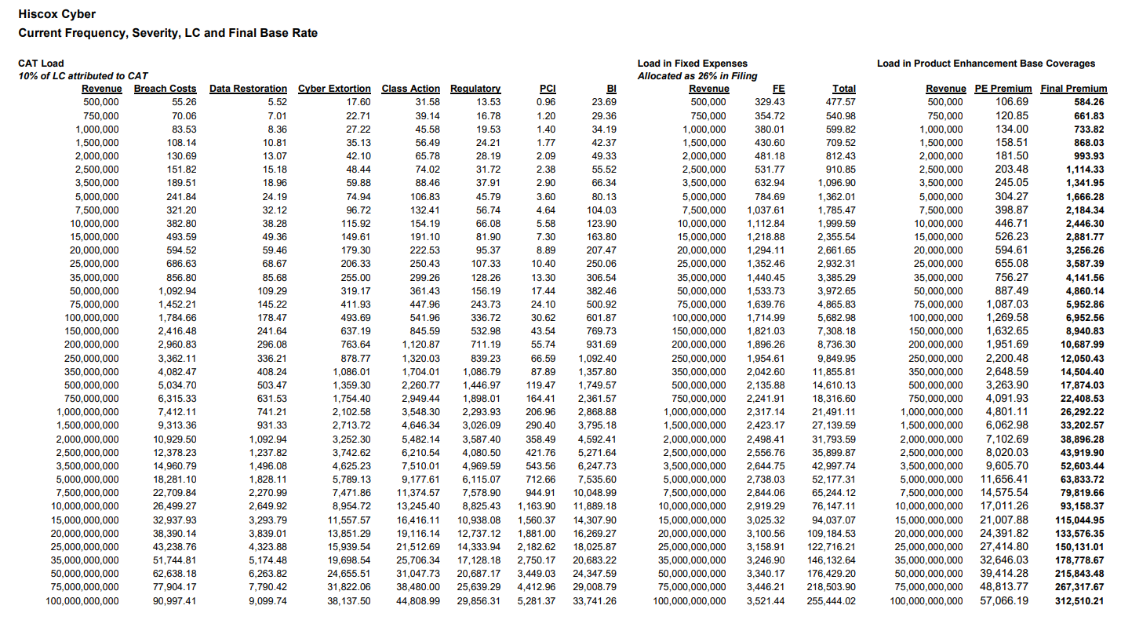
(excursion) Premium calculation - how are base rates determined

Slide 49
Approach: Empirical analysis - premium
Cantonael bank - differences in segmentign risk
Company | Base rate calculation metric | Risk Group | Industry Classification | Alpha (overall) | Default Limit | Default Retention
Chubb | Prospective fiscal year revenue | Hazard group 3 | N/A | 1 | 1000000 | 10000
Travelers | Total Assets Under Management | N/A | FINANCIAL INSTITUTIONS | 1 | 1000000 | 25000
NY Marine and General Insurance (HSB policy) | Not elligible - financial services | Not elligible - financial services | Not elligible - financial services | 1 | 1000000 | 10000
Zurich NA | annualized projected revenue | Tier 3 | 60 Depository Institutions | 1 | 1000000 | 25000
AmeriTrust ( Lloyd’s) | Annual Revenue | No risk groups (small business policy) | No risk groups (small business policy) | 1 | 1000000 | ?
Hiscox Insurance | Revenue (marginal calculation) | N/A | ALL COMPANIES | 1 | 1000000 | 10000
BCS | Total Interest Income x Rateable Revenue Factor | Group 1 | Financial Institution - Community, State, Credit Union | 1 | 1000000 | based on revenue
HSB | Combination of Annual Revenue and Net Operating Expenses | Occupancy Tier 4 | N/A | 1 | 1000000 | 10000

Slide 50
Approach: Empirical analysis - premium
INCLUDE PROFIT LOAD
INCLUDE COMMISSION CALC
INCLUDE REINSURANCE
INCLUDE INFORMATION SEC PRICING
INCLUDE SEVERITY AND PROBABILITY ASSUMPTIONS

Slide 51
Heterogeneous coverage
Chubb
Zurich
Computer Fraud Base Rates
Miscellaneous Professional E&O Electronic Funds Transfer Fraud
Social Engineering Fraud
Technology E&O Electronic Social and Printed Media
Network Extortion Threat
Cyber Privacy and Network Liability
Cyber lncident Response
Business Interruption and Extra Expense
Digital Data Recovery
Contingent Business Interruption and Extra Expenses
Cyber Event Service Interruption Off Premise,
Cyber Event Service Interruption Time Element
Protection and Preservation of Property, Expediting Expense
Computer Forensic Expense, and Digital Asset Replacement Expense

Slide 52
Chubb | Zurich
Computer Fraud Base Rates | Cyber Event Service Interruption Off Premise
Miscellaneous Professional E&O Electronic Funds Transfer Fraud | Cyber Event Service Interruption Time Element
Social Engineering Fraud | Protection and Preservation of Property, Expediting Expense
Technology E&O Electronic Social and Printed Media | Computer Forensic Expense, and Digital Asset Replacement Expense
Network Extortion Threat
Cyber Privacy and Network Liability
Cyber lncident Response
Business Interruption and Extra Expense
Digital Data Recovery
Contingent Business Interruption and Extra Expenses

Slide 53
Case 2: Regional Bank (1/2)
Case summary
Revenue: CHF 529 Mio.
Asset size: CHF 2 bn.
Industry: Financial services
Market Model
Business model
Main challenges: frequency and severity
Process: Underwriting meeting
Risk model: Radically increased
Types of risk (difference)
Main challenges: Cyber Extortion
Reinsurance: Treaty reinsurance agreement typically necessary
Environment
Regulatory: PCI Fines
Cyber extortion

Slide 54
Case 3: Large hospital (1/2)
Case summary
Revenue: CHF 1.5 bn.
Asset size: CHF 1.4 bn.
Industry: Healthcare
Market Model
Business model
Process: underwriting meeting
Large ticket size
Risk model
Types of risk (difference): Ransomware
Reinsurance: Treaty agreement typically necessary
Risk assessment: number of patient records

Slide 55
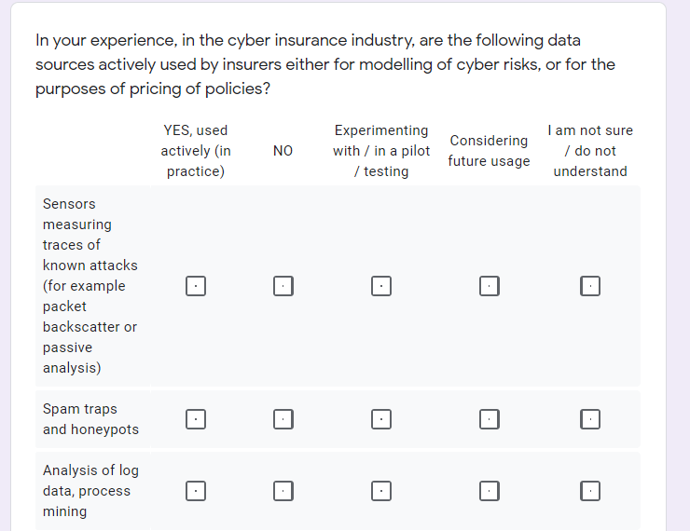
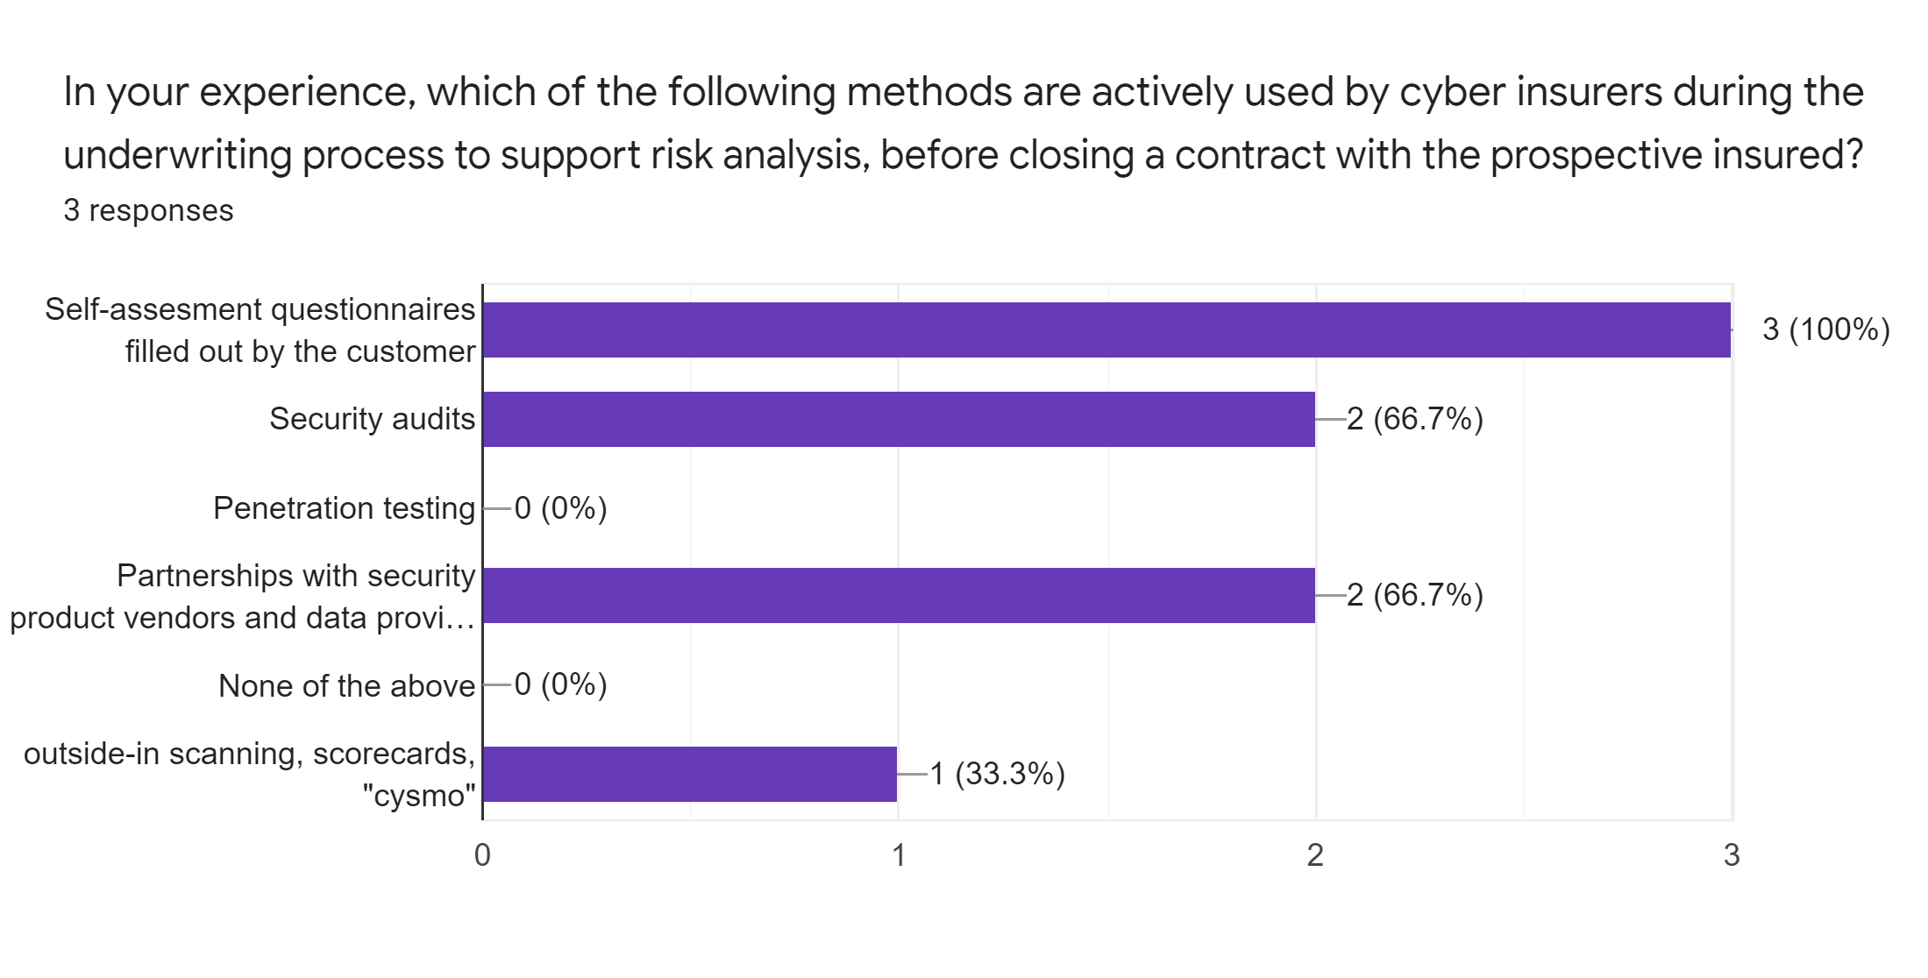

Slide 56
Case 2: Regional Bank (2/2)
Proposed premium according to generalised method (with alpha 1): ADD
Pricing scheme: Base rate with modifications
Risk analysis & assessment:
Metric: Base rate based on Industry/AUM (e.g. Travelers Insurance), underwriting meeting
Key Coverage:
Cyber Extortion
Most relevant Exclusions:
Contractual liability

Slide 57
Case 3: Large hospital (2/2)
Proposed premium according to generalised method: ADD
Pricing scheme: Base rate with modifications (business interruption waiting period, no. of patient records)
Risk analysis & assessment:
Key Coverage elements:
Data Breach/Compromise
Most relevant Exclusions:
Bodily injury
Damage to physical systems
Fines, penalties

Slide 58
Approach: Empirical analysis - premium
Sensitive data policy … .

Slide 59
Cantonal bank
Specific considerations when insuring in financial service
Case study goal: Showcase what modificators underwriters work with to set premiums and what information is required and differences in understanding risk.
Hospital company
Demonstrate how sensitive data like those in healthcare can be insured
Case study goal: Demonstrate how sensitive data like those in healthcare can be insured and what implications are on premiums, Consider how business interruption coverage premiums are covered.

Slide 60
Premium: Academia vs. Industry
Industry approaches
Base rates with modifications
Underwriter P&L responsibility
Manual premium setting for the enterprise
Expert opinions
Questionnaires for SMEs
Underwriting meeting for enterprise
Approches identified in research
Economic
Correlation based
Operational Risk
Epidemic

Slide 61
Approches identified in research | Industry approaches
Economic | Base rates with modifications
Correlation based | Underwriter P&L responsibility
Operational Risk | Manual premium setting for the enterprise
Epidemic | Expert opinions
 | Questionnaires for SMEs
 | Underwriting meeting for enterprise

Slide 62
CI Framework - First Pillar
BUSINESS MODEL
FUNDAMENTALS
ECONOMIC ASPECTS
CUSTOMER EXPECTATIONS
ORGANISATIONAL PERSPECTIVE
PROCESS
Fundamentals of insurance and reinsurance
Excursion of cybersecurity
Insurability criteria
Adjacent insurance policies.
Loss types
Quantification
Value added services
Market segment differences
ER Model
Institutions
Actors / Stakeholders
Go-to-market distribution
Underwriting process model

Slide 63
CI Framework - First Pillar
RISK MODEL
ECONOMIC CHALLENGES
TYPES OF RISK
RISK STRUCTURE
HIGHER-ORDER RISK TRANSFER
Asymmetric information
Adverse selection
Moral hazard
Correlated risk
Action of people
Systems and technology failures
Failed internal processes
External events
Parties
Layers
Model
Catastrophe bonds
Exploit derivatives
Cyber reinsurance

Slide 64
CI Framework - Second Pillar
CALCULATION
PRICING SCHEMES
RISK ASSESSMENT
RISK ANALYSIS
Flat rate pricing
Base rate with modifications
Information security pricing
Alternative methods
Risk modeling
Security audit
Cyber security questionnaire
Underwriter discretion
Company-specific criteria
Organizational
Technical
Policies and procedures
Legal and compliance
Input: Risk assessment
Annual loss expectancy
Other considerations (TBD)

Slide 65
CI Framework - Second Pillar
CONTRACTUAL
COVERAGE
TERMS & CONDITIONS
EXCLUSIONS
Partial insurance
Full insurance
Loss types covered
Cover limits
Deductibles
Conditions
Co-payments
Typical exclusions
Other exclusions
Special cases
DECLARATIONS
Premium schedules

Slide 66
CI Framework - Third Pillar
REGULATORY & LEGAL
REGULATORY BODIES
REGULATORY GUIDELINES
LEGAL FRAMEWORK
EU: EIOPA, ENISA, EC
Excursion: Germany
Excursion: Switzerland
GDPR
Solvency II
EU NIS Directive
Legal considerations

Slide 67
Reinsurance for case studies ??
Type of reinsurance:
Quota Share,
Surplus,
Excess of Loss,
Excess of Loss Ratio (Stop-Loss)
Pools
Facultative and treaty?
Bank - facultative?
SME facultative

Slide 68
CI Framework - Third Pillar
OTHER
INFORMATION SHARING
TRENDS / INNOVATIONS
CYBER SECURITY SERVICE PROVIDERS
CI data sources
Statistics, insurance tables
Self-service
External infrastructure scans
Parametric cyber insurance
Dynamic premiums
On-demand
Subscription models
Itemised insurance

Slide 69
Finally, some markets use the term “network” and “network security failure” in describing the IT system involved, and a breach of that system. Corvus uses the term “computer system”.
Business Income Loss and Extra Expenses incurred during the Interruption Period directly as a result of the total, or partial, or intermittent interruption or degradation in service of an Insured's Computer System caused directly by a Privacy Breach, Security Breach, Administrative Error or Power Failure.
ust as with Contingent Business Interruption, policy language isn’t universal, although some language is becoming more standardized over time. Key wordings you may encounter are “security failure” and “system failure” – respectively, a cyber event caused by a cyberattack, and a cyber event caused by an accidental outage. Note that some markets will interpret “system failure” as only administrative error, such as misconfiguring a system update. Others, like Corvus, include unintentional damage beyond admin error, including accidental destruction of digital assets, failure in power supply, and more
Corvus’s Business Interruption coverage triggers as soon as there is any partial or complete interruption, degradation or failure of computer systems. Corvus’s policy would apply the 6 hour waiting period from the time of the initial attack, so even if the company started losing revenue or productivity from the first minute, they would be able to recoup damages starting from that point (assuming the outage eventually eclipsed the 6 hour waiting period).
In addition to determining the front end of the coverage period, brokers should keep an eye out for the best language regarding when the coverage period ends. Many times, companies think they have full functionality back - only to uncover left-over damage to other processes. The Corvus policy covers the insured for the full Interruption period until “the date of full system restoration.” This is broader than some policies that limit the period of coverage to the date that the interruption ends - which could leave the insurer off the hook when it comes to truly bringing the client back to full restoration. Even if systems are fully restored, Corvus offers an additional 30 days following that for additional costs to the business.
Finally, some policies also include limiting wording that says their BI indemnity period ends if the insured did not act with due diligence. At Corvus we trust that the vendors we provide for help with breach response will help the insured to act with due diligence, so we don’t include this wording.

Slide 70
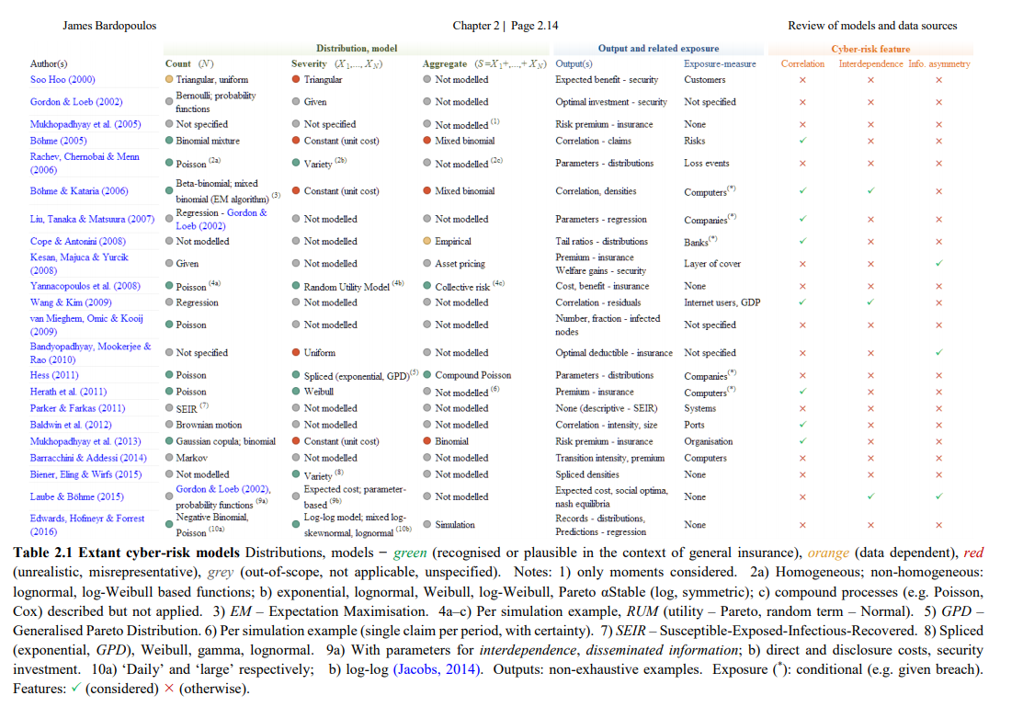

Slide 71
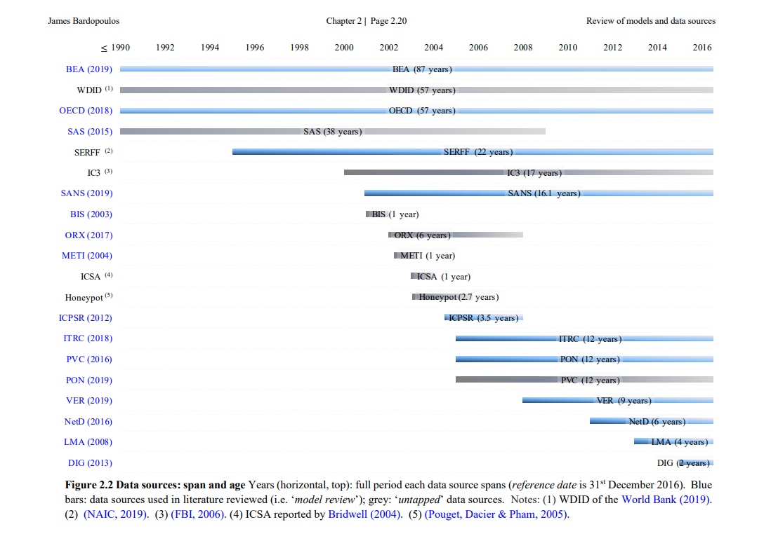

Slide 72
Non proportional reinsurnace
Non-proportional reinsurance is based on loss retention. The ceding insurer agrees to accept all losses up a predetermined level. The reinsurer agrees to reimburse the ceding insurer for losses above the predetermined level and up to the reimbursement limit provided for in contact.

